Slide 1
JOB ROLE : AI - DEVOPS ENGINEER
Sector : IT – ITES
Topic Name : “Overview of DevOps”
PMKK, VIJAYAWADA

Slide 2
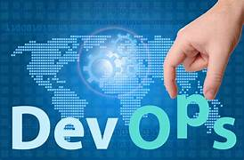
What is DevOps
Definition:
DevOps is a set of practices that combine software development (Dev) and IT operations (Ops) to shorten the development lifecycle and provide
continuous delivery with high software quality.
It is an approach designed to close the gap between software developers( who create the code), and operations teams, who manage the systems and infrastructure.
PMKK, VIJAYAWADA

Slide 3
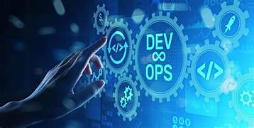
Core Principles of DevOps :
Collaboration: Bridging the gap between
development and operations teams.
Automation: Automating repetitive tasks like
code integration, testing, and deployment.
Continuous Integration & Continuous Delivery (CI/CD)
Ensuring code is always in a deployable state.
Feedback & Monitoring: Continuous feedback for constant improvement.
PMKK, VIJAYAWADA

Slide 4
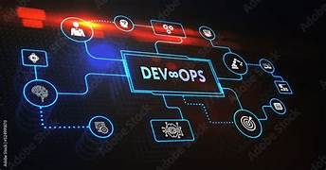
How Did DevOps Come Into Existence?
“The Evolution of DevOps in Software Development”
Traditional Development Model:
  Waterfall Model: A sequential approach where developers and operations teams work in silos (separately).
  Slow and Rigid: Long release cycles
  and delayed feedback loops.
  Communication Gaps: Lack of collaboration between development (Dev) and operations (Ops) teams led to inefficiencies, miscommunication, and slower delivery times.
Result: Bottlenecks in development and deployment cycles, causing friction between teams.

Slide 5
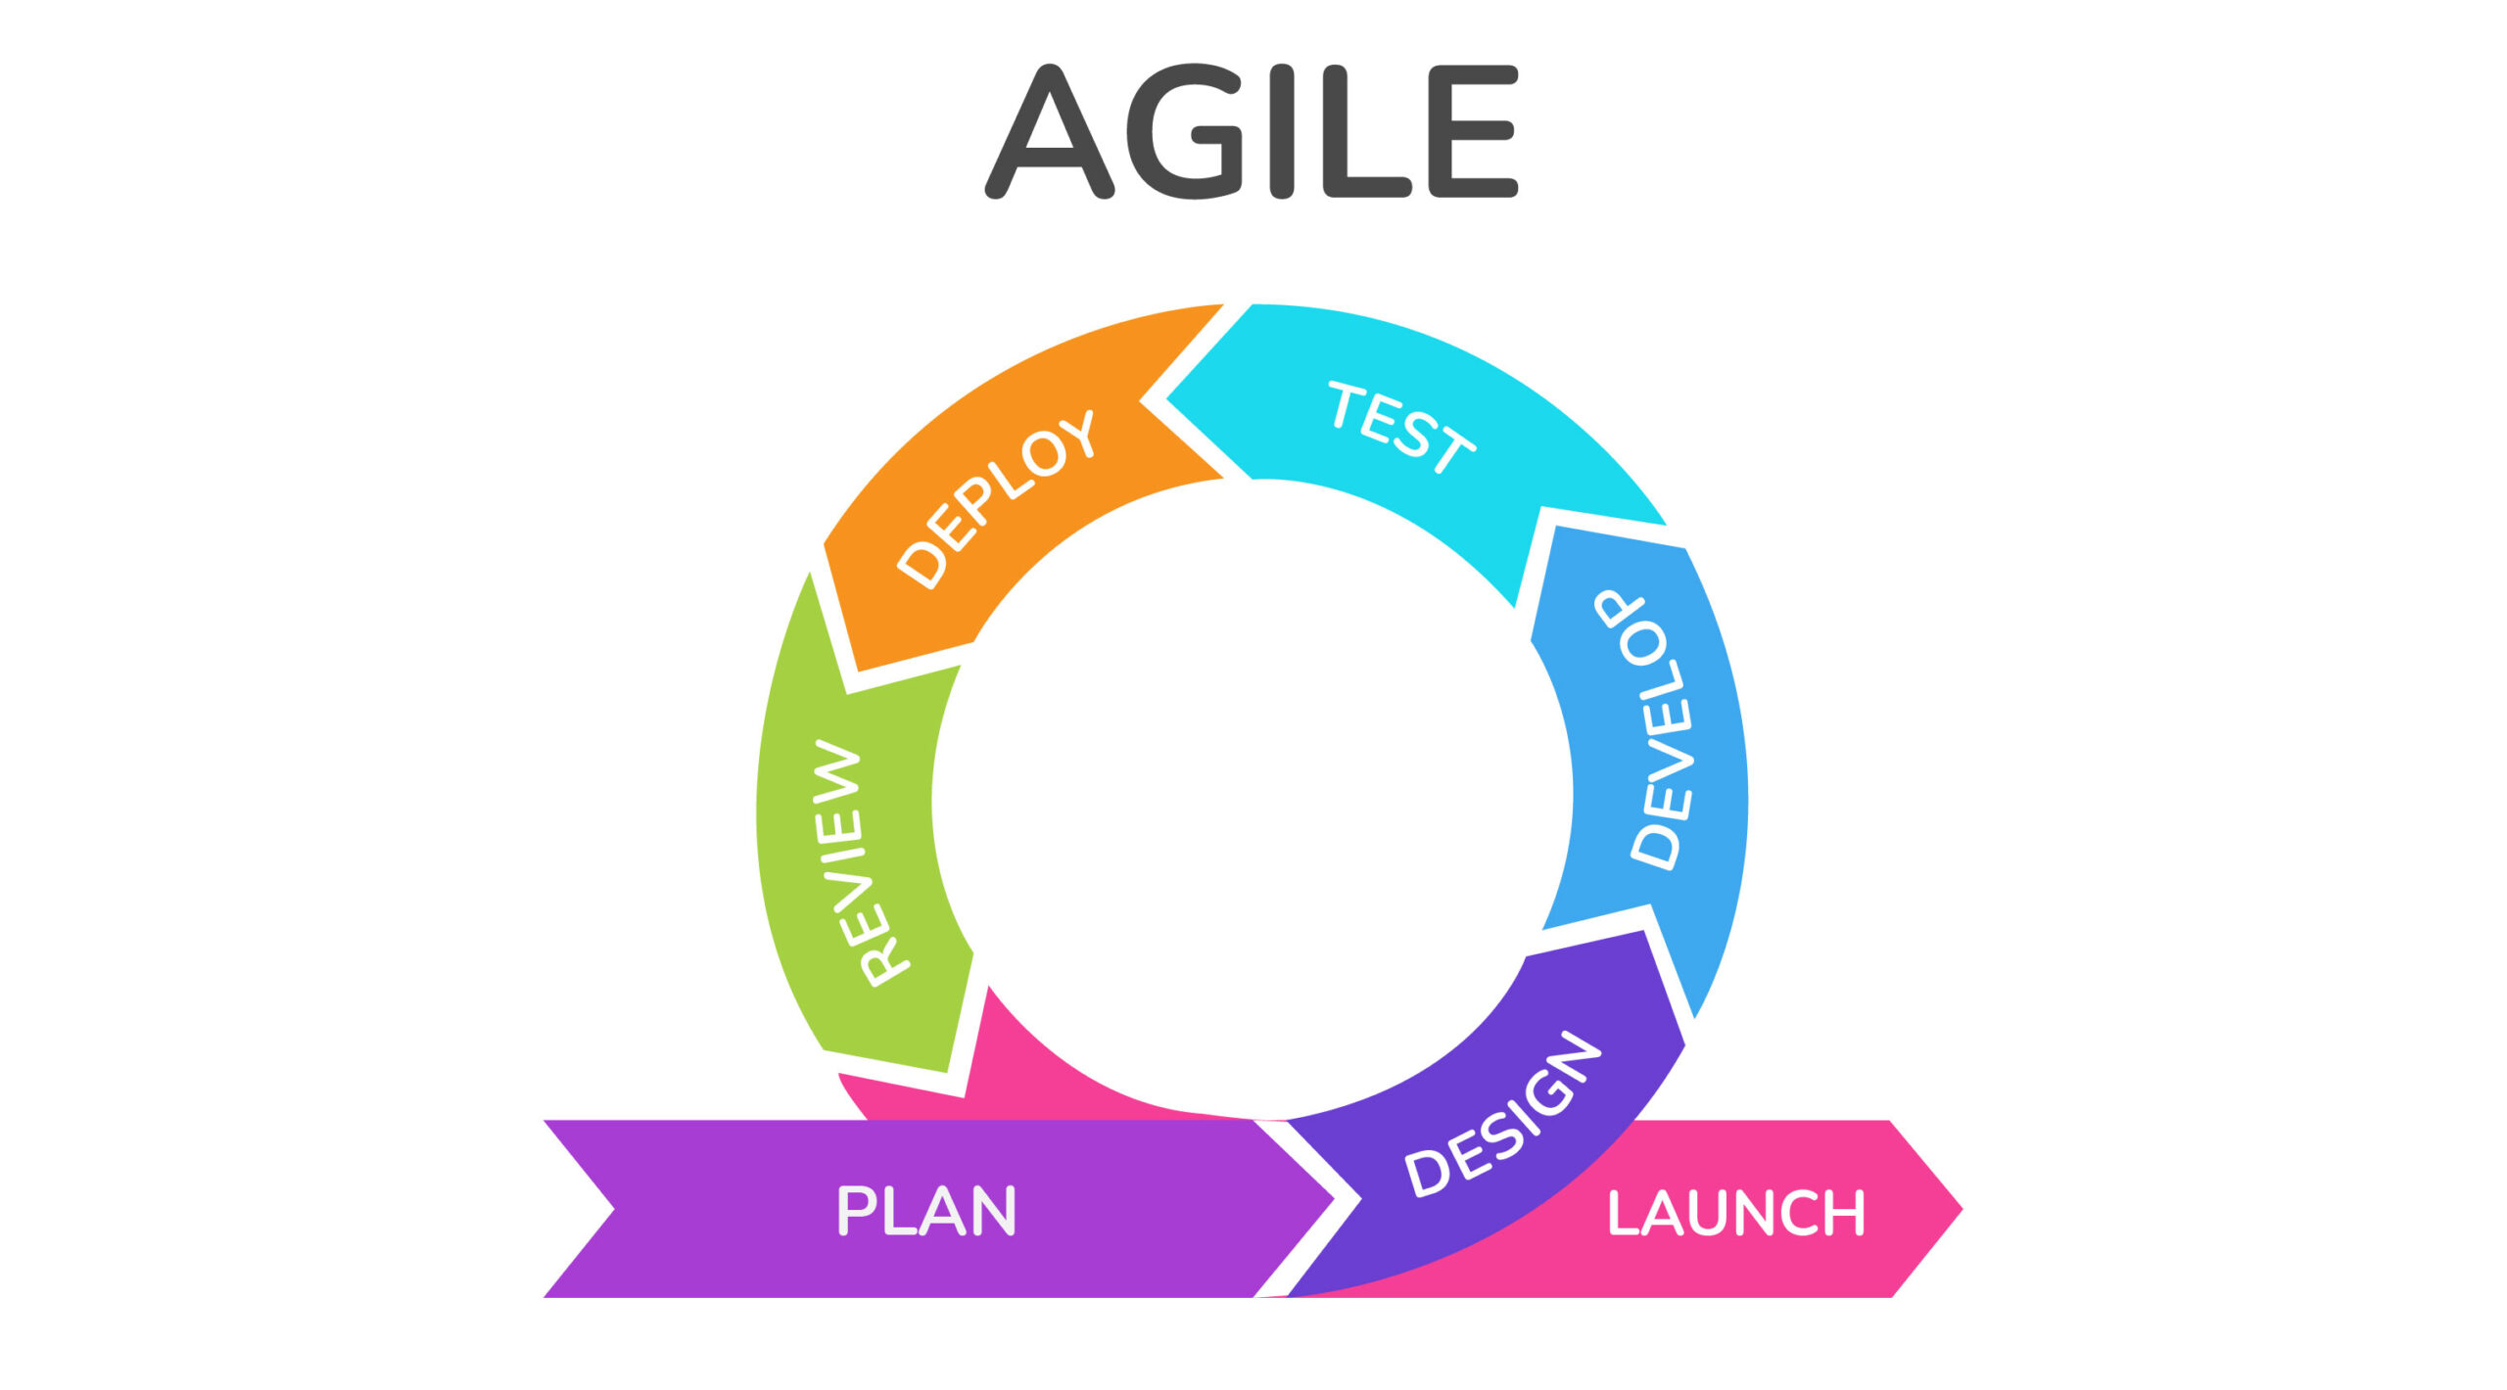
The Rise of Agile and Continuous Delivery:
Agile Methodology (2001):
  Focus on iterative development, rapid feedback, and cross-functional teams.
  Dev and Ops teams still worked separately, but Agile started emphasizing collaboration.
Challenges with Agile Alone:
  Despite faster development cycles, deployment
  to production remained slow and risky.
Continuous Delivery (CD):
  The need for faster, more reliable deployments led to the concept of Continuous Integration (CI) and Continuous Delivery (CD), streamlining the release process and reducing bottlenecks.
PMKK, VIJAYAWADA

Slide 6
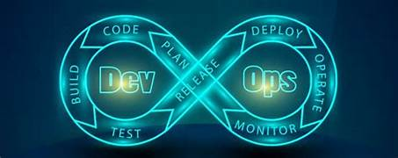
The Emergence of DevOps (2009)
Origins of DevOps:
Patrick Debois (2009): Coined the term "DevOps" after organizing the first DevOps Days conference in Belgium.
DevOps was born from the need to break down the silos between Dev and Ops teams.
DevOps aims to unify development, quality assurance,
and operations to enable faster, more reliable software
releases.
Milestones in DevOps History:
2009: First DevOps Days conference.
2010-2012: DevOps practices gain popularity among tech companies
like Netflix, Amazon, and Google.
2013-2015: Growth of DevOps tools like Jenkins, Docker, and
Kubernetes.
PMKK, VIJAYAWADA

Slide 7
Why We Need DevOps
Faster Time to Market
DevOps enables the teams to deploy updates quickly by automations.
Improved Collaboration
Breaks down silos between Dev and Ops, fostering better communication.
Increased Automation
Automates repetitive tasks (e.g., testing, deployment), reducing manual errors
and improving efficiency.
Higher Quality and Reliability
Continuous integration and testing improve software quality and reduce bugs.
Scalability and Flexibility
Enables scalable infrastructure through automation (Infrastructure as Code),
adapting to changing demands.
PMKK, VIJAYAWADA

Slide 8
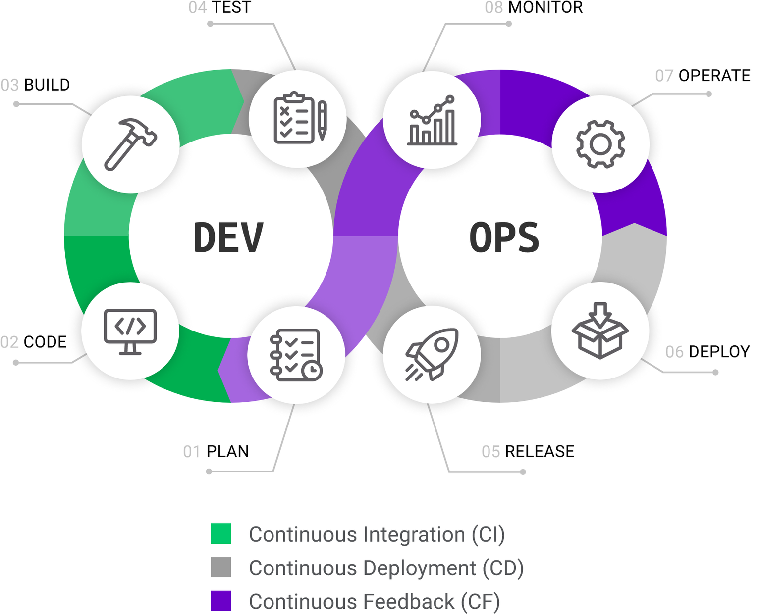
DevOps Lifecycle
PMKK, VIJAYAWADA

Slide 9
Key Phases in the DevOps Lifecycle:
Plan: Define requirements, features, and scope. Collaborative planning
across teams to align goals and tasks.
Develop: Developers write and test code in short, iterative cycles. Focus
on continuous integration (CI) to ensure smooth integration of new
code.
Build: Code is compiled and built into deployable artifacts.
Automation of build and integration processes ensures
consistency.
Test: Automated testing is run to ensure the quality of the software.
Unit, integration, and performance testing are performed.
PMKK, VIJAYAWADA

Slide 10
Release: Software is packaged and prepared for deployment. The release process
is automated to minimize manual intervention and reduce errors.
Deploy: Automated deployment to various environments (e.g., staging,
production). Can include rolling updates, blue-green deployments, etc.
Operate : The application is monitored in production. Operations teams ensure
that the infrastructure is stable and performant.
Monitor: Continuous monitoring and logging track application performance and
user feedback. Metrics and real-time data help identify issues early.
Feedback and Continuous Improvement: Continuous feedback from
monitoring, end-users, and automated tests leads to improvements in
code, processes, and infrastructure.
PMKK, VIJAYAWADA

Slide 11
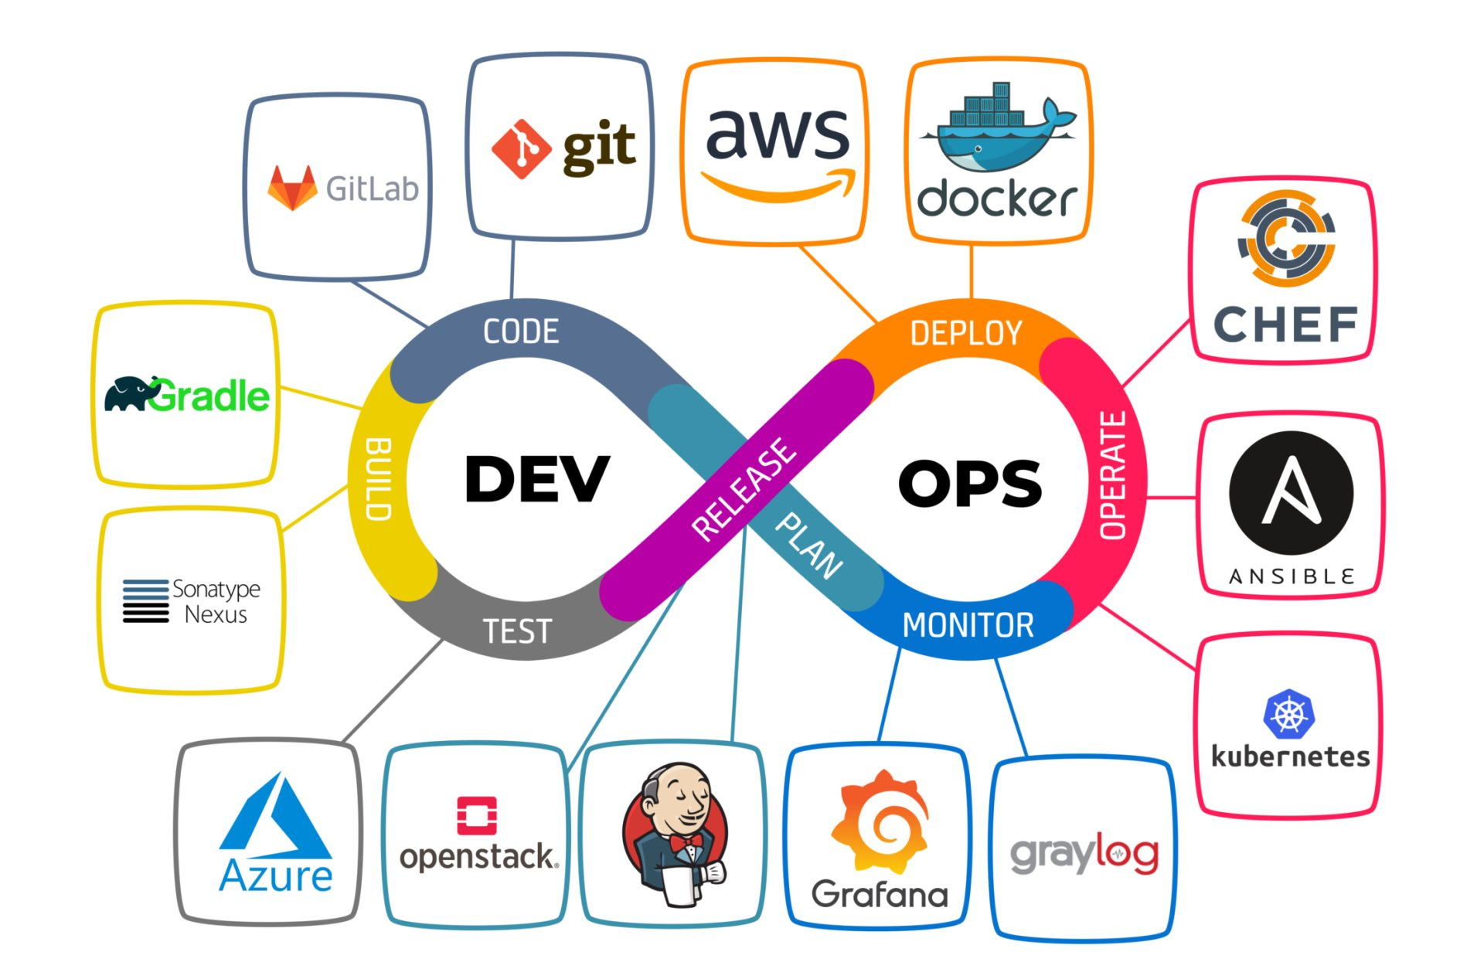
DevOps Tools Overview:
Version Control: Git, GitHub, Bitbucket.
CI/CD: Jenkins, CircleCI, Travis CI.
Configuration Management: Ansible,
Chef, Puppet.
Containerization: Docker, Kubernetes.
Monitoring: Nagios, Prometheus, Grafana.
PMKK, VIJAYAWADA

Slide 12
Difference Between SRE, DevOps, Cloud Engineer, and Platform Engineer
SRE (Site Reliability Engineer)
Primary Focus:
  Ensures system reliability and availability, with a strong focus on monitoring, automation, and incident response.
Key Responsibilities:
  Reliability: Focus on maintaining high uptime (e.g., SLA/SLO management).
  Automation: Automating repetitive operational tasks.
  Monitoring: Using metrics, alerts, and logs to track system health.
  Incident Management: Actively involved in incident response and post-mortems.
Skills/Tools:
  Monitoring tools (Prometheus, Grafana), automation (Python, Bash), Kubernetes, and observability platforms.
PMKK, VIJAYAWADA

Slide 13
DevOps Engineer:
Primary Focus:
  Bridges the gap between development and operations, emphasizing continuous integration and delivery (CI/CD) pipelines.
Key Responsibilities:
  Collaboration: Facilitates communication between Dev and Ops teams.
  CI/CD Automation: Implements pipelines for automated testing, integration, and deployment.
  Infrastructure as Code (IaC): Managing infrastructure using code (e.g., Terraform, Ansible).
  Continuous Improvement: Focus on improving processes to accelerate delivery.
Skills/Tools:
  Git, Jenkins, Docker, Kubernetes, Terraform, Ansible, CI/CD platforms.
PMKK, VIJAYAWADA

Slide 14
Cloud Engineer:
Primary Focus:
  Designs, manages, and supports cloud infrastructure and services (e.g., AWS, Azure, Google Cloud).
Key Responsibilities:
  Cloud Infrastructure Management: Provisioning, scaling, and managing cloud resources.
  Security & Compliance: Ensuring security and compliance within the cloud environment.
  Cost Optimization: Managing cloud cost efficiency and monitoring usage.
  Automation: Automating the cloud resource provisioning and scaling.
Skills/Tools:
  AWS, Azure, Google Cloud, Terraform, Kubernetes, CloudFormation, and container orchestration.
PMKK, VIJAYAWADA

Slide 15
Platform Engineer:
Primary Focus:
  Builds and maintains internal platforms that support both development and operational workloads.
Key Responsibilities:
  Platform Design: Develops self-service platforms for developers and operations teams.
  Infrastructure as Code (IaC): Manages infrastructure automation to support scalable systems.
  Tooling & Frameworks: Builds and maintains tools that enhance developer productivity (e.g., CI/CD pipelines, monitoring tools).
  Efficiency & Reliability: Ensures that internal tools are reliable and cost-efficient.
Skills/Tools:
  Kubernetes, Docker, CI/CD tools, Terraform, AWS, monitoring solutions.
PMKK, VIJAYAWADA

Slide 16
Comparison Table
Role | Primary Focus | Key Responsibilities | Skills/Tools
SRE | System reliability and uptime | Incident management, automation, SLA/SLO management, monitoring | Prometheus, Grafana, Kubernetes, Python, Bash
DevOps | CI/CD, collaboration between Dev and Ops | CI/CD automation, Infrastructure as Code, process improvement, collaboration | Jenkins, Docker, Kubernetes, Terraform, Git
Cloud Engineer | Cloud infrastructure management and optimization | Cloud resource provisioning, security, scaling, cost optimization | AWS, Azure, Google Cloud, Terraform, CloudFormation
Platform Engineer | Building internal platforms for development & ops teams | Platform design, IaC, tool maintenance, supporting developer workflows, automation | Kubernetes, Docker, Terraform, AWS, CI/CD tools
PMKK, VIJAYAWADA

Slide 17
Career Opportunities in DevOps
High Demand: Increasing need for skilled DevOps professionals in both startups
and large enterprises.
Diverse Roles: Opportunities as DevOps Engineers, SREs, Cloud Engineers,
Platform Engineers, and Automation Specialists.
Cross-Disciplinary Skills: Professionals with a mix of coding, system
administration, cloud management, and collaboration skills are
highly sought after.
Attractive Salaries: DevOps-related roles are among the highest-paying in the
tech industry due to the specialized skills required.
Continuous Learning: Ongoing advancements in tools, methodologies, and
cloud technologies mean a career in DevOps offers continuous
growth and opportunities to learn.
PMKK, VIJAYAWADA

Slide 18
DevOps syllabus as per NSDC
Linux Operating system
  a.Commands
  b. Shell script.
2. GIT & GITHUB
3. Jenkins
4. Docker
5. Kubernetes
6. Ansible
7. MAVEN
8. SonarQube
PMKK, VIJAYAWADA

Slide 19
Add-on we are offering
AWS Cloud Services:
S3
EC2
VPC
RDS
ROUTE53
ACM
CLOUD FRONT
SNS and SQS
CLOUDTRAIL and CLOUD WATCH
IAM
ELASTIC BEANSTALK
EKS
ECR, ECS
PMKK, VIJAYAWADA

Slide 20


Slide 21

PMKK, VIJAYAWADA

